Slide 1
Software Engineering and Architecture
Concurrency
A Classic Java Take on it

Slide 2
Disclaimer…
I have relatively little experience in large scale, realistic, development of parallel and concurrent programs ☹
The ‘handling concurrency’ scene is a vast topic, and has transformed considerably over the last decade!
Multicore processors
And OS/Libraries to take advantage of them !
We will only treat classic and basic issues and solutions!
So, read up on the material once you are ‘out there’…
The problems are the same, but solutions become better…

Slide 3
Motivation
Concurrency = many ‘objects’ executing at the same time
Why?
Modelling: This is how the world is!
Many people working in parallel, collaborating, sharing…
Quality Attributes of our architecture
Performance
Responsiveness / Availability

Slide 4
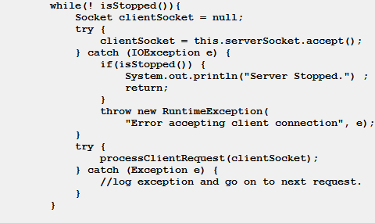
Responsiveness
Sometimes our computations take quite a while to complete
Example:
User 1 searches for all flights to Bali
Server is busy requesting a lot of external booking systems
Meanwhile
User 2 wants to search for flights to Tokyo
But what happens here?

Slide 5
Solution
Just like one cashier in Føtex can only handle a limited number of customers at the same time; so can a single thread
Solution: Employ more cashiers / threads!
However… Poses its own set of challenges!

Slide 6
Analyzing Code…
… is based upon a sequential execution of statements
Exercise: What is ‘a.balance()’ after the last withdraw()?
Assuming the balance is 0.00 at the start…
interface Account {
public boolean deposit(long amount);
public boolean withdraw(long amount);
public long getBalance();
}
class SingleThread {
public static void main(String[] args) {
Account a = new AccountImpl();
a.deposit(500);
a.withdraw(100);
a.withdraw(100);
}

Slide 7
Program Thread…
The program thread weaves through methods and statements…
In machine code
Register PC
Program counter
Increments for every instruction
Some instructions change PC
JMP 47 =
Change PC to address 47
I.e. a method call…
main
<<create>>
a
deposit
withdraw
withdraw

Slide 8
Two Threads!
Forelæseren
lønkonto
PBS
deposit
withdraw
withdraw

Slide 9
Three Types of Concurrency
When more than one thread executes in a program, we say that it is concurrently executed, it is a concurrent program.
Three categories of concurrent programs
Independent threads
Like running your music player program while coding in IntelliJ
Shared resources
Like two threads reading/writing to the same account object
Collaborating threads
Like one thread inserting into a buffer and assuming some other thread will remove those items from the buffer

Slide 10
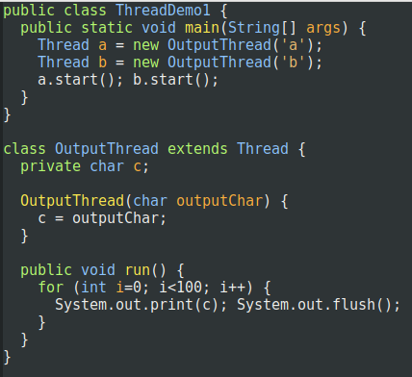
Java
Java was one of the first mainstream languages to have threads as part of the language!
Before that, it was the job of the OS
Processes
Coded using OS libraries
Core class:
Thread
Part of a framework!

Slide 11
Thread
Anatomy
Create a thread
Call start();
Will execute ‘run()’
Exercise
How many threads?
What does it do?
And what is the output?

Slide 12
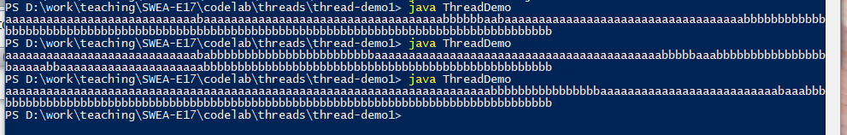
Output
The hallmark of concurrent programs: non-determinism
Welcome to debugging hell!!!
Welcome to testing hell!!!
Testing is almost impossible, as there is a lot of randomness involved

Slide 13
Scheduling
Threads execute concurrently
Abstractly speaking, even if they do not always in practice !
In my youth we had one CPU
Today you 4, 8, 12, …, and several thousands in your GFX card
Concurrency is (partly) simulated by
Thread scheduling
Preemptive:
Thread runs for n milliseconds, is interrupted and the scheduler then picks the next thread for execution
(Non-preemptive): Thread ‘yields()’ to signal thread change…

Slide 14
Thread States
Any thread in a program are in one of several states
An incomplete list for Java includes
RUNNABLE: running or able to run (‘running’/’ready’)
100 threads may be runnable but only 1 [2, 4, 8] are actually executing code, the others are waiting for the scheduler to switch to them (ready/parked)
BLOCKED: not executing, but waiting for a lock
Used to handle ‘shared resources’, see later…
WAITING: not executing, but in a wait-set, waiting
Used to handle ‘producer-consumer’ / collaborating threads

Slide 15
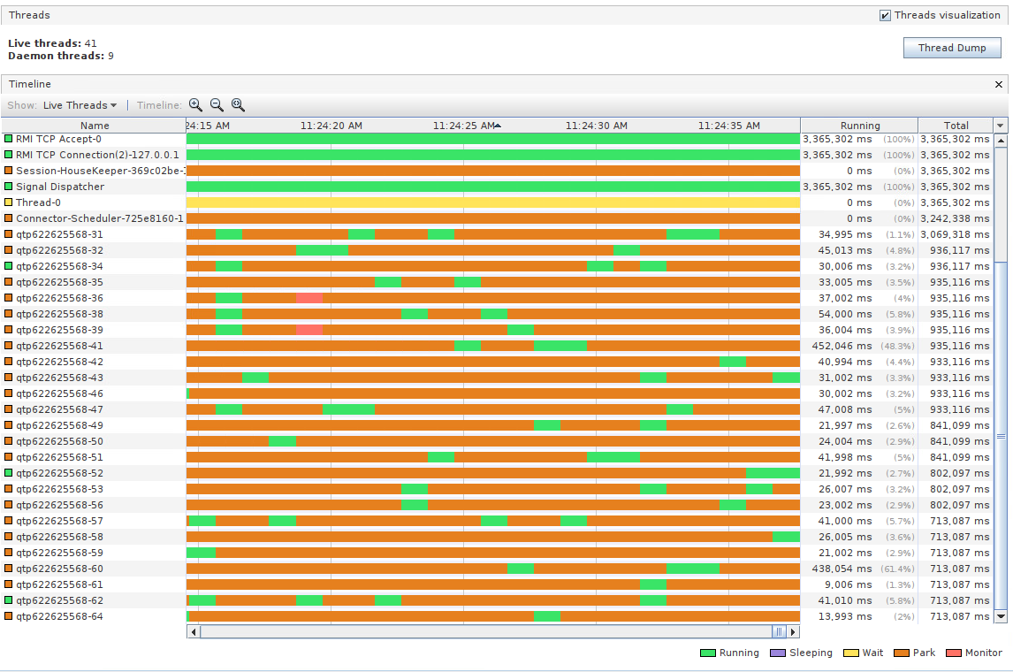
VisualVM can show thread states
Runnable threads are either running or parked…

Slide 16
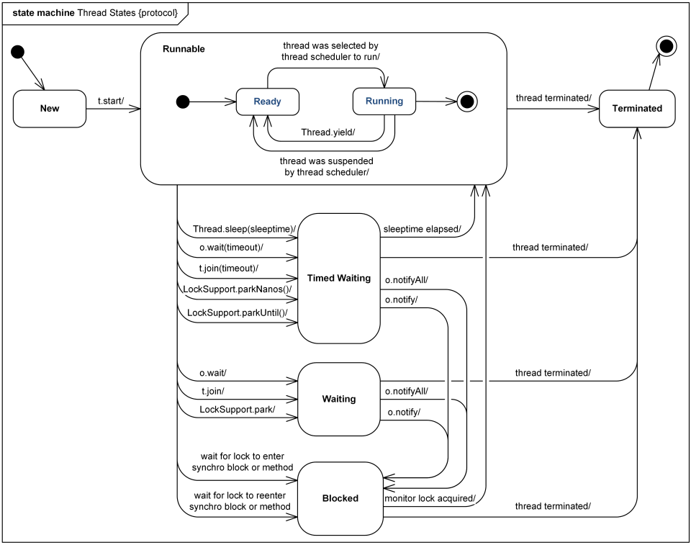
Thread States
Source: www.uml-diagrams.org

Slide 17
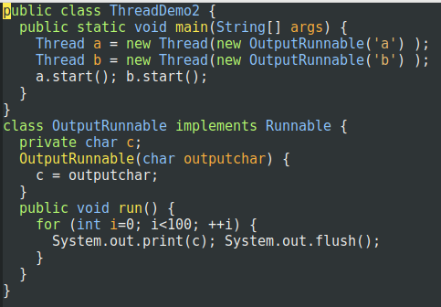
Subclassing? No no no ☺
Program to an interface! Runnable interface
Process
Provide Thread object with the Runnable instance
Exercise:
What design pattern?
Notes:
Algorithm to execute concurrently = Strategy pattern.

Slide 18
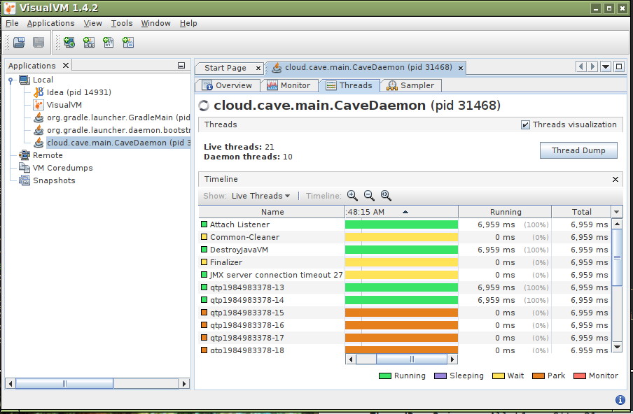
Overviewing Threads
You may install ‘visualvm’, and overview a lot of the inner workings of your application’s threads (and heap and…)

